Slide 1
Criptomoeda e Blockchain Introdução à Technologia
Seminário
2019
Nuno Santos

Slide 2

Criptomoeda e Bitcoin
Criptomoeda: dinheiro virtual ou digital que assume a forma de tokens (fichas/passes) ou “moedas”
Bitcoin: A primeira e mais popular criptomoeda
Criada em 2008 por uma pessoa (ou grupo) de nome Satoshi Makamoto
Notes:
Definição
https://www.investopedia.com/tech/most-important-cryptocurrencies-other-than-bitcoin/
A cryptocurrency, broadly defined, is virtual or digital money which takes the form of tokens or “coins.”

Slide 3
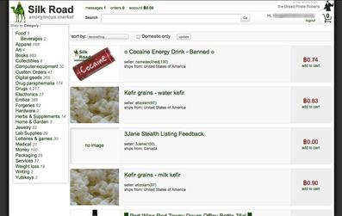
Bitcoin: A criptomoeda da Dark Web

Slide 4
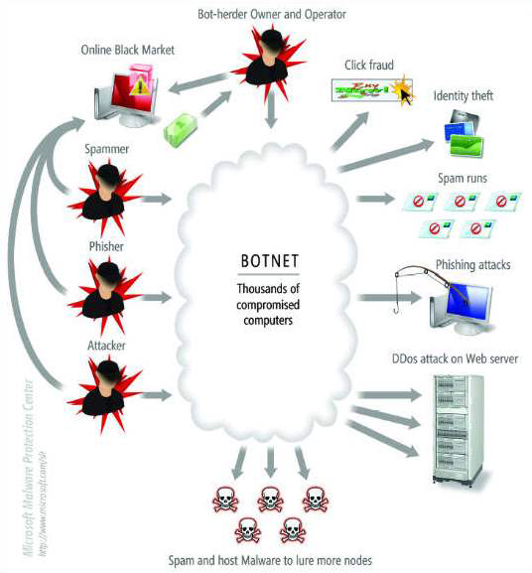
Bitcoin no mercado negro das botnets
There’s a global market around botnets
Who pays:
Internet Advertising companies for downloading adware onto vulnerable PCs
Companies who send spam, viruses and other malware
…

Slide 5
Bitcoin no pagamento de ransomware
Notes:
https://coincenter.org/link/why-ransomware-criminals-use-bitcoin-and-why-that-could-be-their-undoing

Slide 6
Ramsomware: um grande problema
https://www.ccn.com/news/ransomware-thugs-indiana-county-130000-bitcoin/2019/07/13/
https://www.newsbtc.com/2019/07/12/trump-blasts-bitcoin-for-illicit-use-as-ny-college-is-hit-with-2m-ransomware/
Notes:
Days after the U.S. Conference of Mayors passed a resolution opposing the payment of ransoms by cities following a ransomware attack La Porte County’s government has done the opposite after its files were encrypted. According to WSBT-TV, the municipality has paid a Bitcoin ransom worth approximately $130,000 to cyber attackers who encrypted its files.

Slide 7
Bitcoins usadas não só por cibercriminosos
https://www.lifewire.com/big-sites-that-accept-bitcoin-payments-3485965
Who Accepts Bitcoin as Payment?
https://99bitcoins.com/bitcoin/who-accepts/
Wikipedia
Microsoft
Expedia
Overstock
KFC
Playboy
Subway
Amazon (não directamente)
ExpressVPN
Benfica
AT&T
…
Notes:
Grandes comerciantes

Slide 8
Evolução do preço e volume de Bitcoin
https://en.bitcoinwiki.org/wiki/Bitcoin_history
Preço da Bitcoin (BTC) entre 2009 e 2019
1 BTC = 3,587,520.69 Angolan Kwanza = 9,187.77 Euro = 10,370.70 United States Dollar
(14 Julho 2019)

Slide 9
Além da Bitcoin, existem muito mais criptocoins
(Junho 2019)
https://www.investopedia.com/tech/most-important-cryptocurrencies-other-than-bitcoin/
Litecoin (LTC)
Ethereum (ETH)
Zcash (ZEC)
Dash (DASH)
Ripple (XRP)
Monero (XMR)
Bitcoin Cash (BCH)
NEO (NEO)
Cardano (ADA)
EOS (EOS)
Notes:
Beyond that, the field of cryptocurrencies is always expanding, and the next great digital token may be released tomorrow, for all anyone in the crypto community knows.

Slide 10
Observatórios de criptomoeda online
https://www.cryptocurrencychart.com/
(Julho 2019)

Slide 11
Overview of online payments

Slide 12
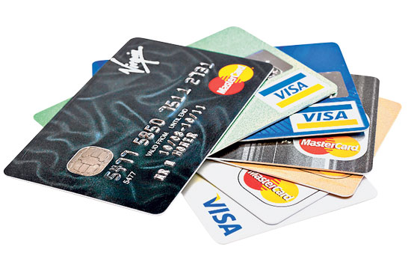
Typical e-commerce payment systems
Credit cards
Still the dominant online payment method in United States
Notes:
https://eleventhirthypm.wordpress.com/2013/11/10/the-five-properties-of-currency-not-money/

Slide 13
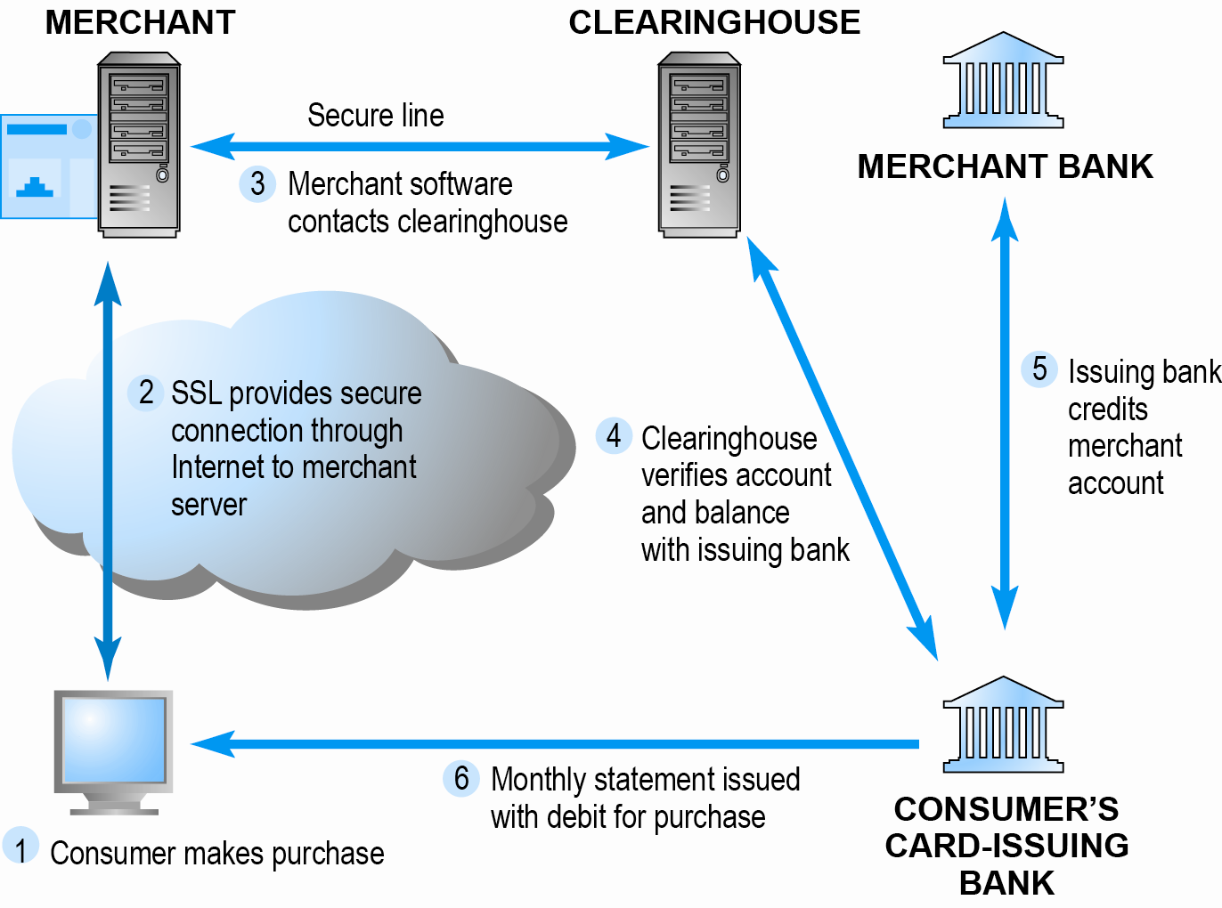
How an online credit transaction works
Notes:
A clearing house is a financial institution formed to facilitate the exchange (i.e., clearance) of payments, securities, or derivatives transactions.
SIBS em Portugal: Responsável por multibanco, etc.

Slide 14




Alternative online payment systems
Online stored value systems
Based on value stored in a consumer’s bank, checking, or credit card account
e.g.: PayPal, Amazon Payments
Virtual currencies
Circulate within internal virtual world
e.g.: Linden Dollars in Second Life, Facebook Credits
Based on algorithm that generates unique tokens that can be used in “real” world
e.g.: Bitcoin

Slide 15
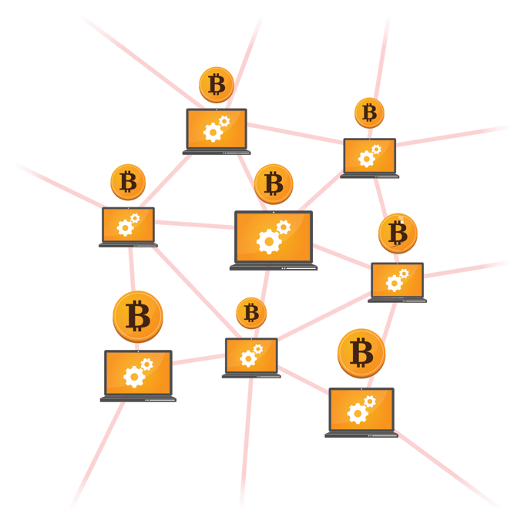
Bitcoin
A decentralized, peer-to-peer cryptocurrency
Commonly denoted as BTC
Creation is attributed to Satoshi Nakamoto
His true identity is unknown: person? group?
Bitcoin stimulates scarcity to raise its value in two ways:
There are a finite number of Bitcoins that can be created (21 million)
Bitcoins become progressively harder to “mine” as more enter circulation

Slide 16
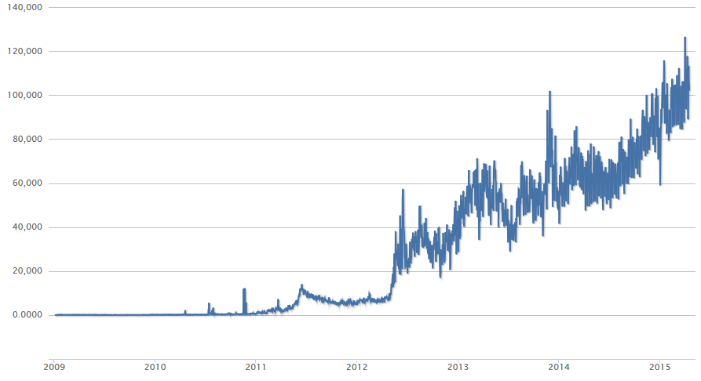
Bitcoin’s popularity has been increasing…
Number of bitcoin transactions per day
Notes:
Cotação hoje: 3222 eur!

Slide 17
…including (especially?) among cybercriminals
Silk Road = the black market Amazon
Can purchase drugs, weapons, child pornography, hire hackers, hire assassins, and more. Purchases are made with Bitcoins (+Tor)

Slide 18
Why is Bitcoin used by cybercriminals?
Fully decentralized
No need to rely on a bank to mediate the transaction
Private
Transactions based on pseudonyms

Slide 19
How Bitcoin works

Slide 20
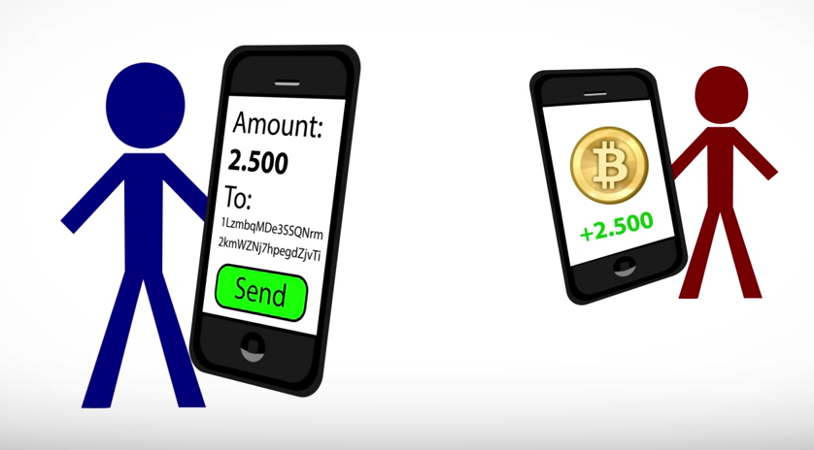
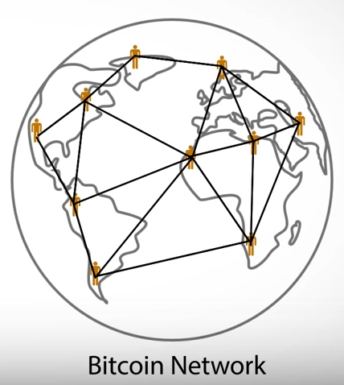
Basic operation
Users have local Bitcoin wallet that lets them perform transactions, i.e., send bitcoins over to another user

Slide 21
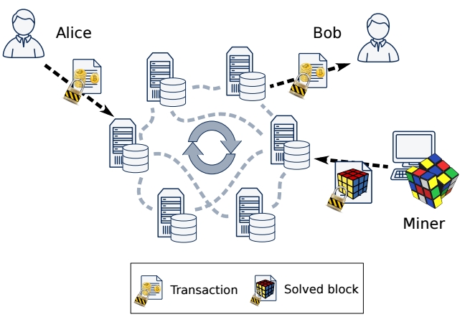
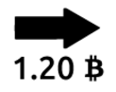
Bitcoin system architecture
Bitcoin is a decentralized payments system
Peers of the Bitcoin network re-broadcast valid transactions received from clients
Clients (payers and payees) are identified by public keys of their choice
In practice clients use hashes of these public keys
Notes:
Each peer stores the received transactions in a (separate) database. When a client receives bitcoins he
can verify that they were not spent before by contacting a (small) subset of peers.

Slide 22
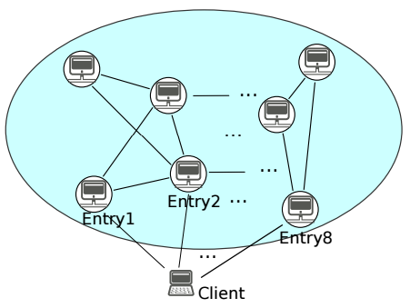
Bitcoin P2P network
Peers of the Bitcoin network connect to each other over an unencrypted TCP channel
There is no authentication in the network, so each node just keeps a list of IP addresses associated with its connections
Bitcoin peers (clients and servers) try to maintain 8 outgoing connections

Slide 23
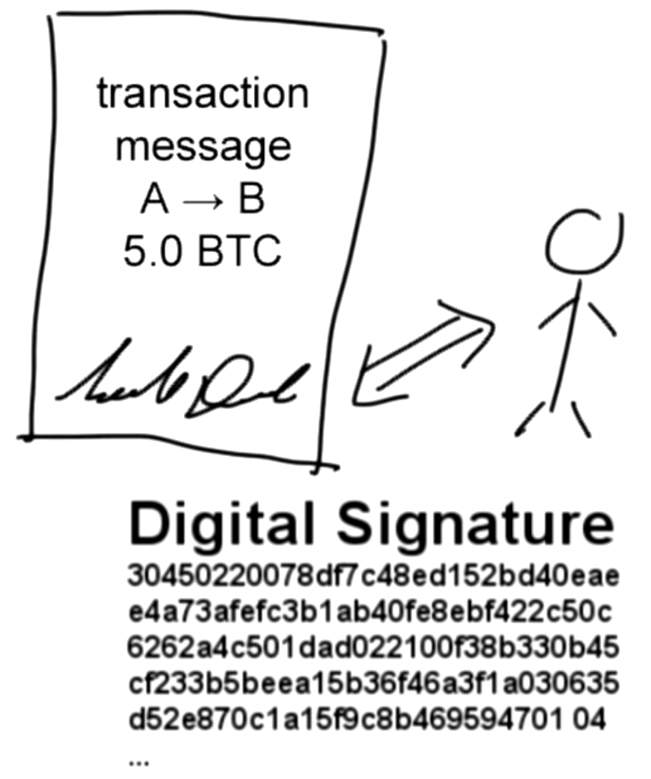
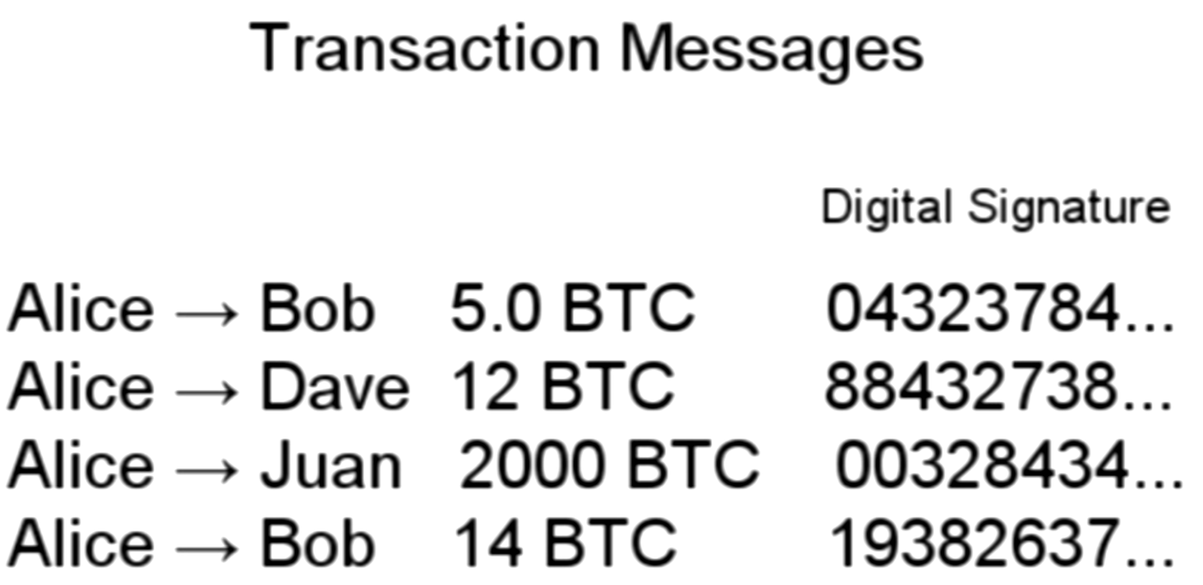
Bitcoin transaction messages
Every account address has an associated public key pair for signing transactions
Public keys also identify the receivers’ addresses

Slide 24
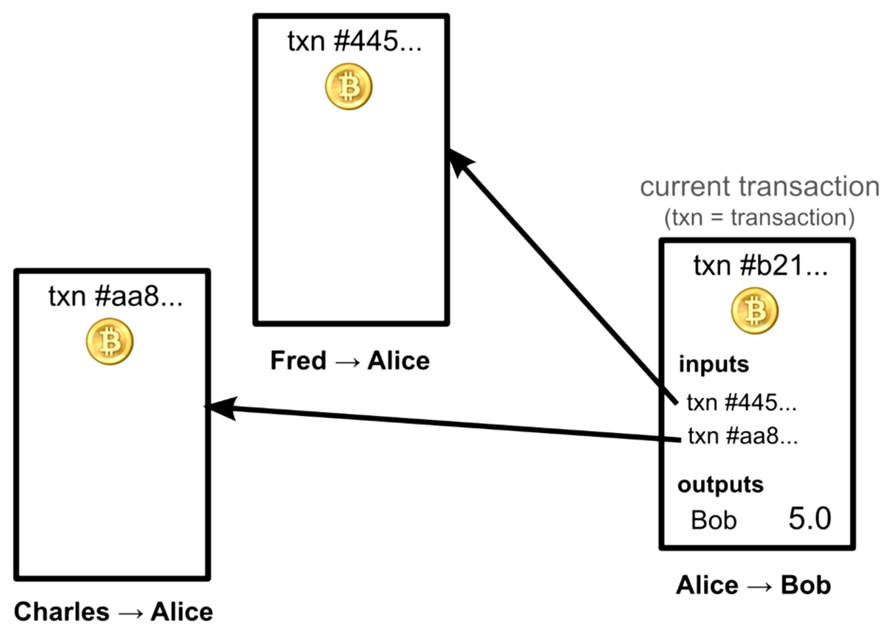
Transaction graph
Current transaction references previous txs called inputs
To send 5.0 BTC to Bob (output), Alice must reference past txs where she received 5 or more BTCs

Slide 25
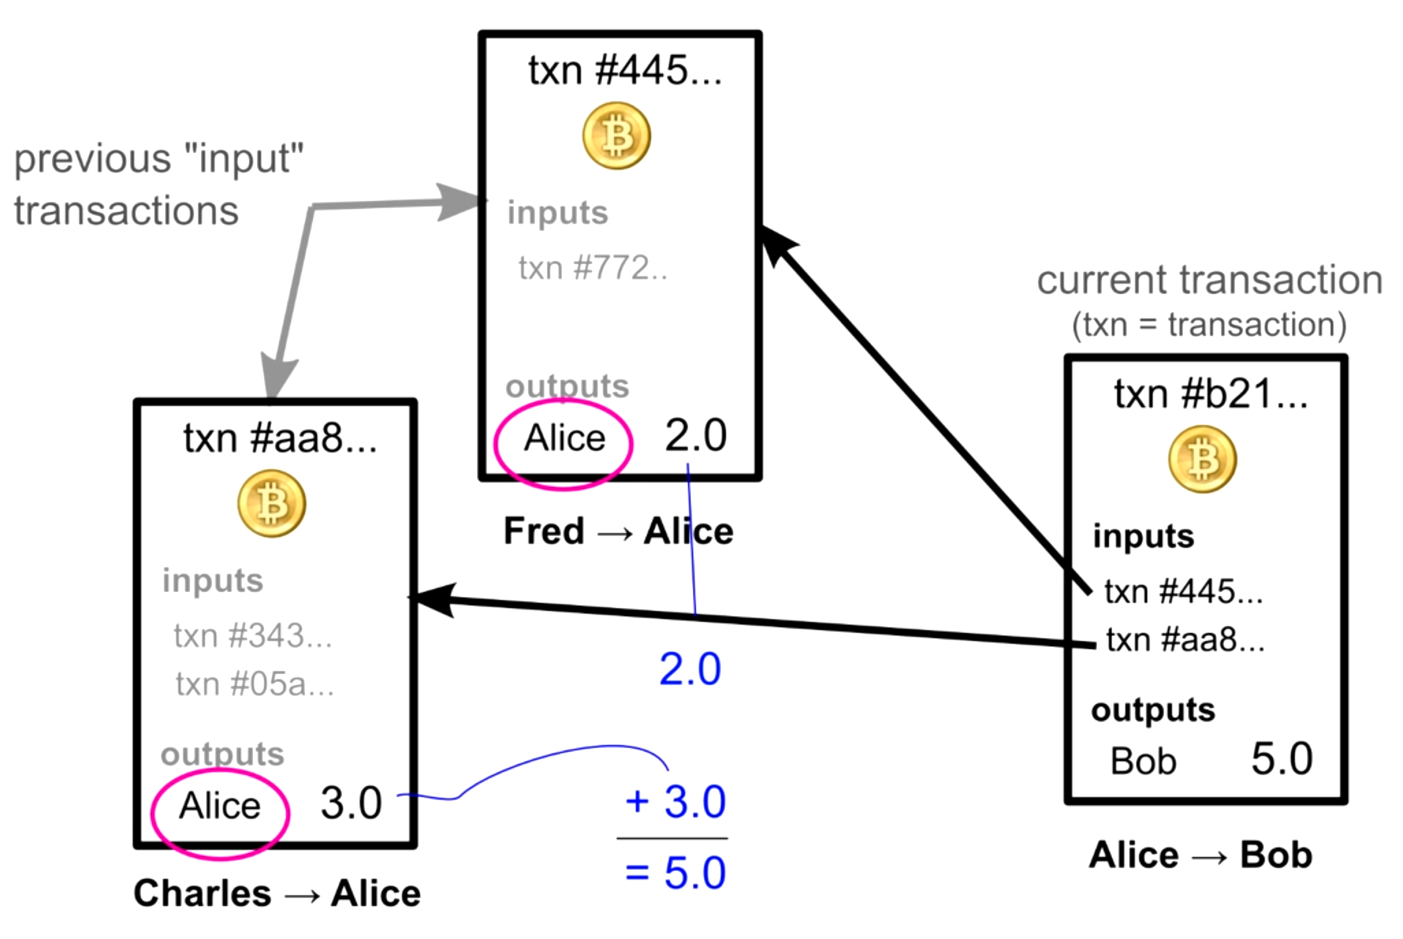
Transaction graph
Other nodes verifying this transaction will check those inputs
Ensure Alice was the recipient, and that the inputs add up to 5+ Bitcoins

Slide 26
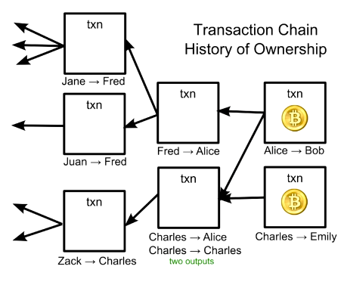

The tx graph keeps the whole tx history
Through referenced input links, ownership of Bitcoins is passed along
The validity of each transaction is dependent on previous transactions
For each tx, added outputs must equal added inputs
If your’re sending an amount that doesn’t match one of your inputs, must send remaining amount to yourself

Slide 27
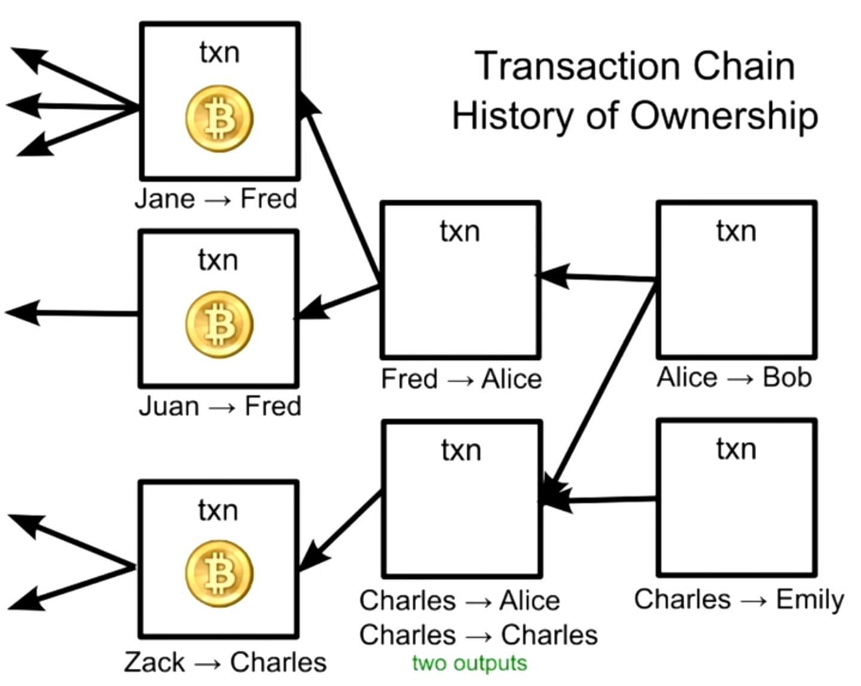
For tx validation, must check until the first tx
Must check the entire chain all the way back to the first tx ever made
Wallet SW downloads and checks every transaction ever made at installation
This can take 24 hours, but needs to be done once
…
First transaction
…
…

Slide 28
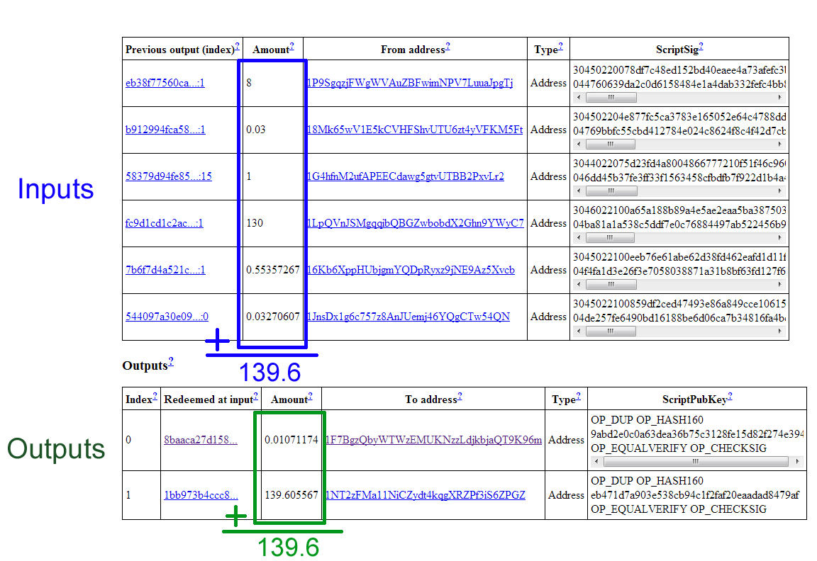
Bitcoin transaction records are public
Notes:
Redeem => pagar
If you redeem a debt or money that you have promised to someone, you pay money that you owe or that you promised to pay.
The blockchain network is designed to make double-spending very difficult, though breaches have occurred in the past. In this way, it functions much like a public ledger, accounting for economic transactions and providing some verification that all bitcoin users are equipped with the same information. Read more: What Does the Bitcoin Blockchain Record? | Investopedia https://www.investopedia.com/ask/answers/063015/what-does-block-chain-record-bitcoin-exchange-transaction.asp#ixzz5Y4PohX6O Follow us: Investopedia on Facebook

Slide 29
Main challenge
How to ensure that the transaction graph is consistent across the entire network?
If the transaction graph is not consistent then the system can be vulnerable to double spending attacks!

Slide 30
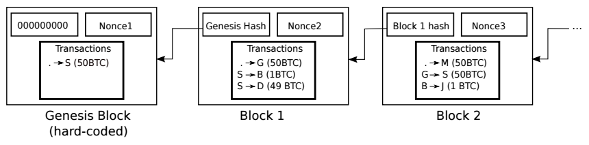
Blockchain to the rescue
Transaction history is organized as a chain of blocks: blockchain
Miners are responsible for generating and appending new blocks to the head of the blockchain
Because this task is resource consuming, miners get rewarded if they succeed at appending a new block into the blockchain

Slide 31
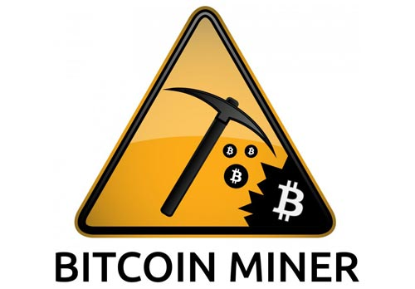
Mining
Mining is the process by which new bitcoin is added to the money supply
Mining also serves to secure the bitcoin system against fraudulent transactions or transactions spending the same amount of bitcoin more than once, known as a double-spend
Miners provide processing power to the bitcoin network in exchange for the opportunity to be rewarded bitcoin

Slide 32
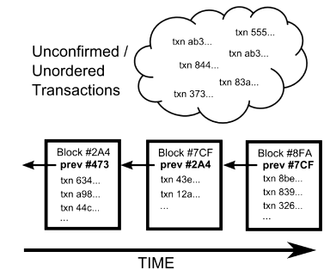
Miners build a block chain
Txs submitted by the clients are not immediately accepted
Instead, txs are placed in a pool of unconfirmed txs
Miners are responsible for collecting unconfirmed txs into blocks and broadcasting those block to the entire network
Each node in the network run a consensus algorithm to agree on a common block sequence order that results in a block chain

Slide 33
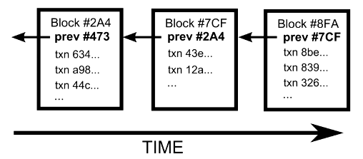
One only block chain in the entire network
A unique block chain exists for the entire network that starts from an initial block called genesis block
Each block has a reference to the previous block, and this places one block after another in time
Genesis block

Slide 34
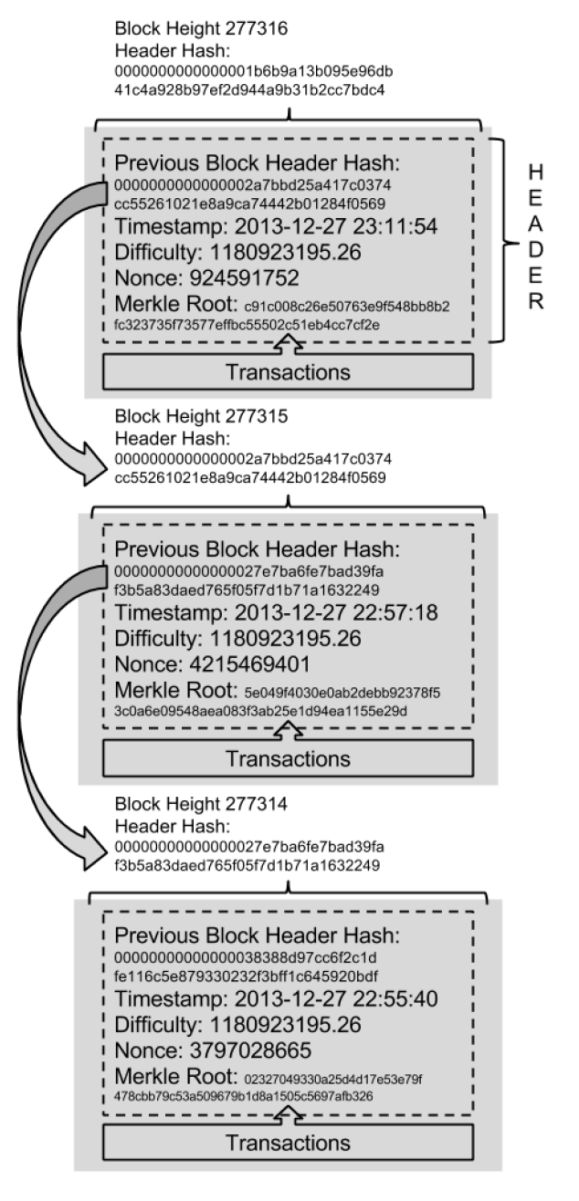
Block chain internals
Each block in the bitcoin block chain contains a summary of all the transactions in the block, using a Merkle Tree
Difficulty measures the work that was taken to create the block

Slide 35

Security through proof-of-work
Generate a block entails solving a difficult math problem based on cryptographic hash algorithm
Miners compete to solve the problem, and get a reward if they manage to solve it first
The solution to the problem (Proof-of-Work) is included in the block and acts as a proof that the miner solved the problem
Reward goes to:
Miner 1
Miner 2
Miner 3

Slide 36
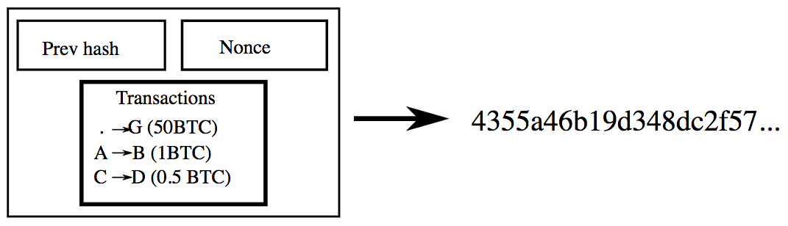
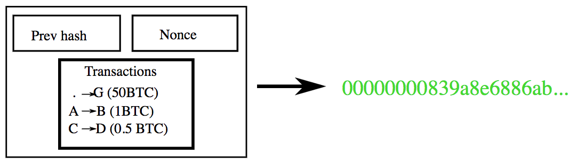
Block generation example
Proof of work: Find nonce and compute hash until you have 32 leading zero-bits
If solution found, broadcast it to the entire network
The longest blockchain is considered the “correct” one
Double spending is prevented because only one blockchain valid
KO
OK!
Notes:
The "nonce" in a bitcoin block is a 32-bit (4-byte) field whose value is set so that the[hash of the block will contain a run of leading zeros. The rest of the fields may not be changed, as they have a defined meaning.
https://en.bitcoinwiki.org/wiki/Nonce

Slide 37
Fraud prevention
Users can trust the block chain that was most difficult to produce
Longest chain wins
If there was a "fake" block chain competing with the real ones the fraudster would have to do as much work as the rest of the network to make their block chain look as trustworthy
Intense work that goes into finding blocks through hashing secures the network against fraud

Slide 38
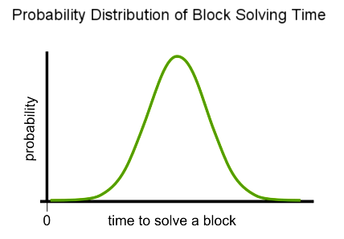
Block generation algorithm finely calibrated
Block generation rate of the network: 1 block / 10 min
The math problem requires brute force trials over large hash space
With every computer in the entire Bitcoin network all guessing numbers, it takes ~10 min on average for a miner to find a solution
The first miner to solve the math problem broadcasts their block
10 min

Slide 39
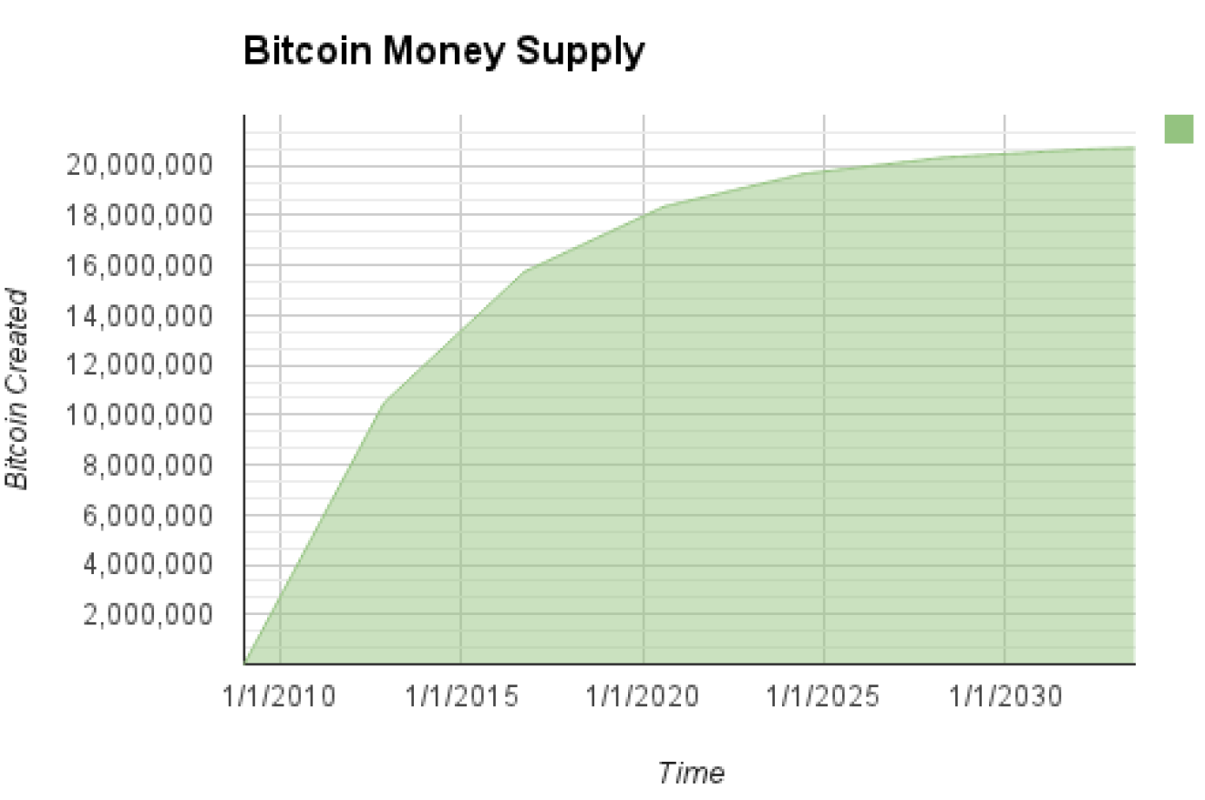
Bitcoin economics and currency creation
Each block, generated on average every 10 minutes, contains entirely new bitcoins, created from nothing
Initial issuance reward was 50 bitcoin / block, and drops ½ every 4 years
Generation rate decreases until 21M bitcoins are generated (by 2140)

Slide 40
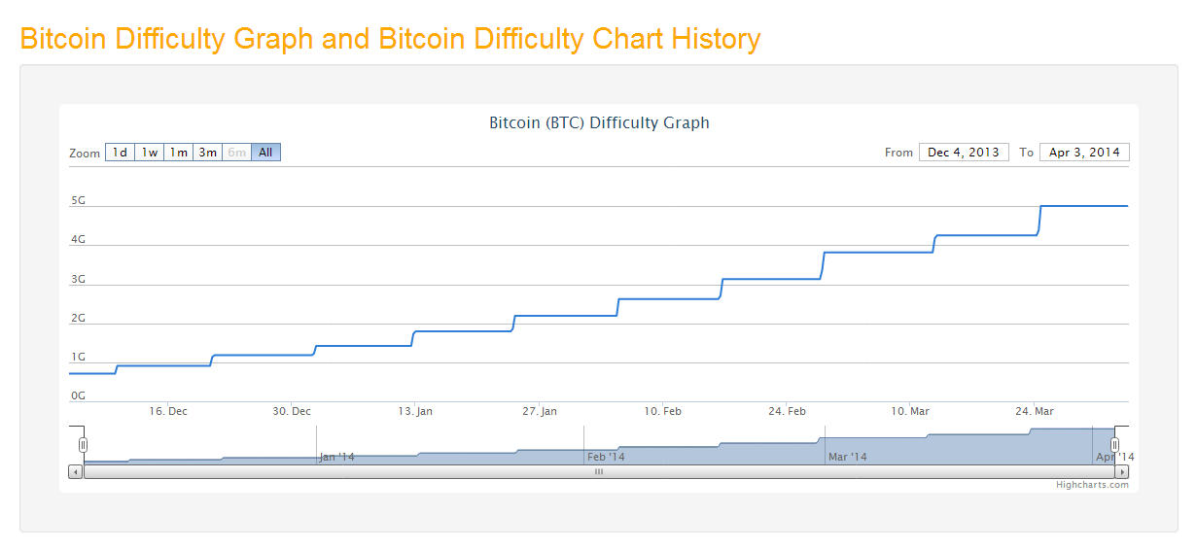
Bitcoin equation difficulty
Equation difficulty determines bitcoin generation rate

Slide 41
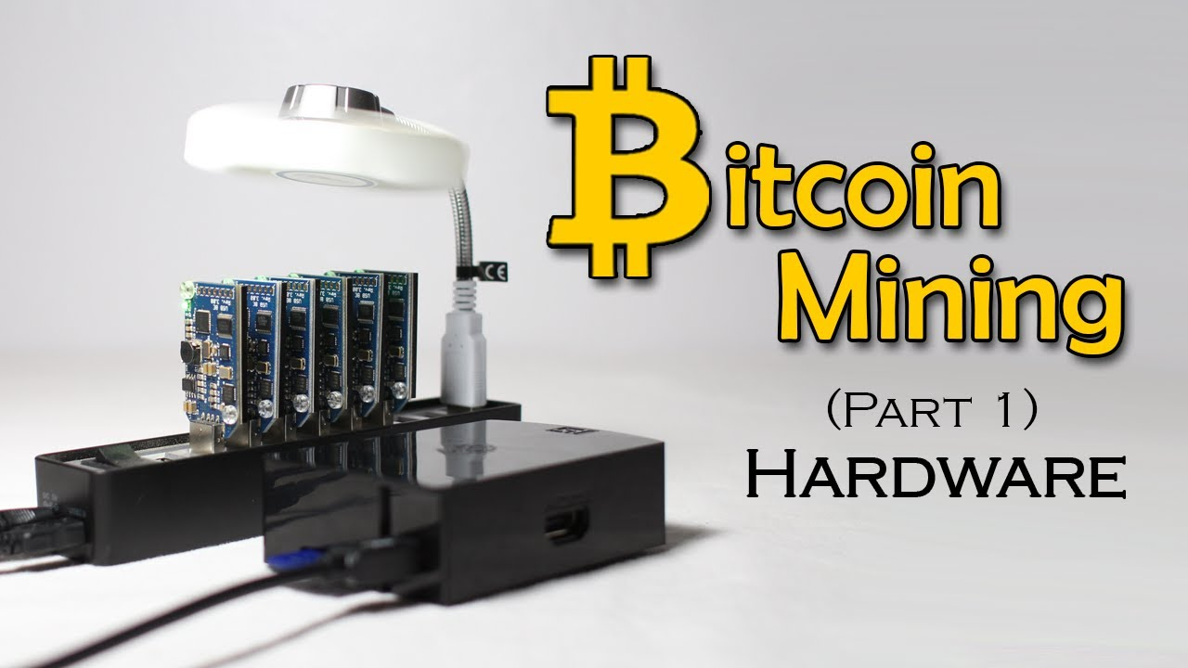
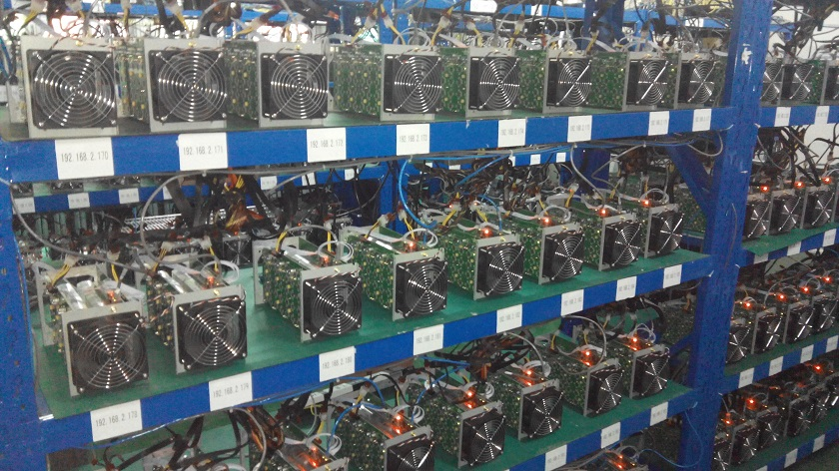
Hardware for bitcoin mining

Slide 42
Bitcoin forensic investigations

Slide 43
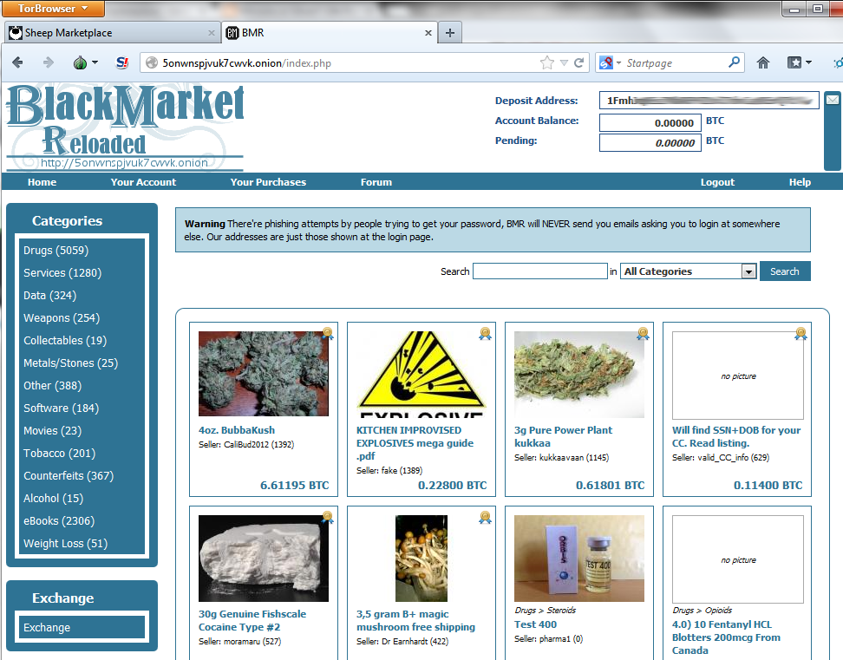
Why are we interested in Bitcoin?
Bitcoin is often thought to be an anonymous means of acquiring nefarious goods online

Slide 44
Is it anonymous?
Indeed, names are not associated with transactions
But, metadata (data about data) of transactions are recorded and publically accessible to anyone, including Law Enforcement without the need of a subpoena or probable cause
Address of both wallets, amount transferred, and more are recorded for each transaction in this “block chain”

Slide 45
Trail obfuscation techniques in Bitcoin
Bitcoin address are not mapped to the real user identity
Bitcoin transactions don’t contain personal information
IP address of client not included in new transactions
User can generate as many Bitcoin addresses as needed

Slide 46
Weaknesses of Bitcoin trail obfuscation
Authentication mechanism in Bitcoin service providers may link user IPs to Bitcoin addresses
The chain of transactions is transparent and traceable
Bitcoin address exposed on the Internet reveal all transactions related to its owner
Gathering some or all inputs when sending Bitcoins to others may expose other addresses of the sender

Slide 47

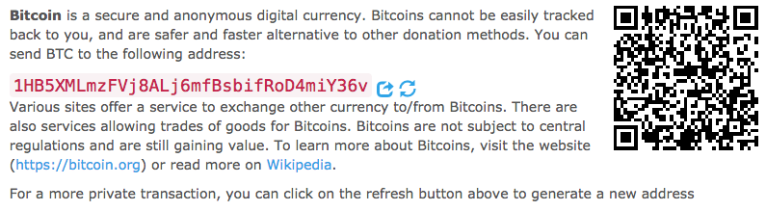
Unlinking Bitcoin addresses
Example: each donation WikiLeaks receive goes to a new public key
Takes advantage of the ability to create new pseudonyms

Slide 48
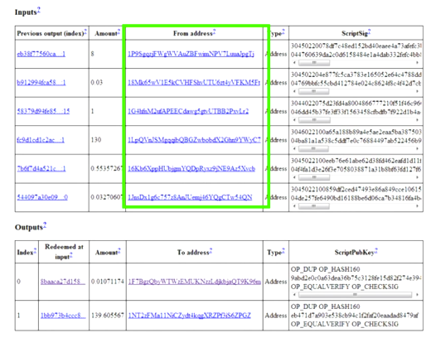
Transactions are linked together
It is possible to determine how money flows by looking at the signatures

Slide 49
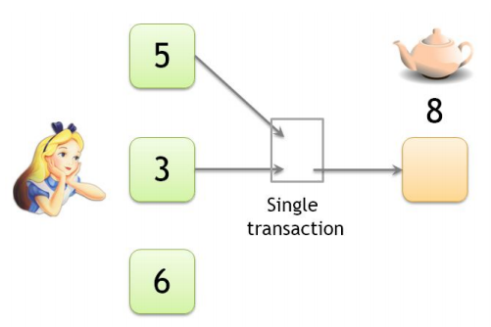
Shared-spending heuristic
Shared spending is evidence of joint control​of the different input addresses
Two inputs to the transaction are most likely under the control of the same user
This process can be repeated and transitively ​link an entire cluster of transactions
To pay for the teapot, Alice has to create a single transaction having inputs that are at two different address. In doing so, Alice reveals that these two addresses are controlled by a single entity.

Slide 50
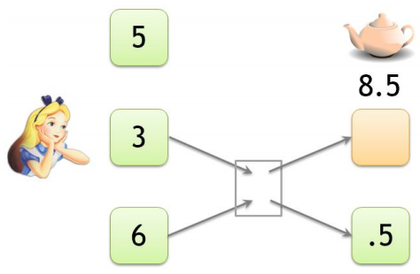
Fresh-change-address heuristic
Wallet software typically generate a fresh address whenever a change address is required
Change addresses generally have never before appeared
Non-change outputs may have appeared previously in the block chain
To pay for the teapot, Alice has to create a transaction with one output
that goes to the merchant and another output that sends change back to herself.

Slide 51
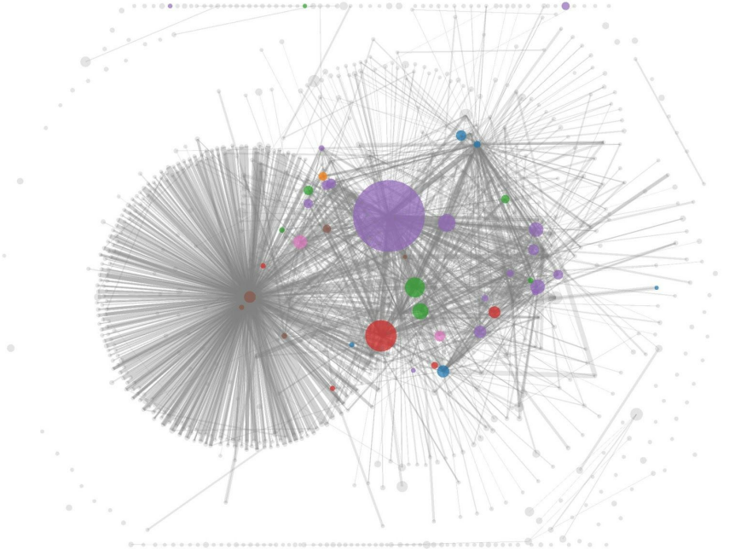
Clustering of addresses
In 2013, researchers combined the shared-spending heuristic and the fresh-change-address heuristic to cluster Bitcoin addresses
Note, however, that these heuristics are error prone
The sizes of these circles represent the quantity of money flowing into those clusters, and each edge represents a transaction.

Slide 52
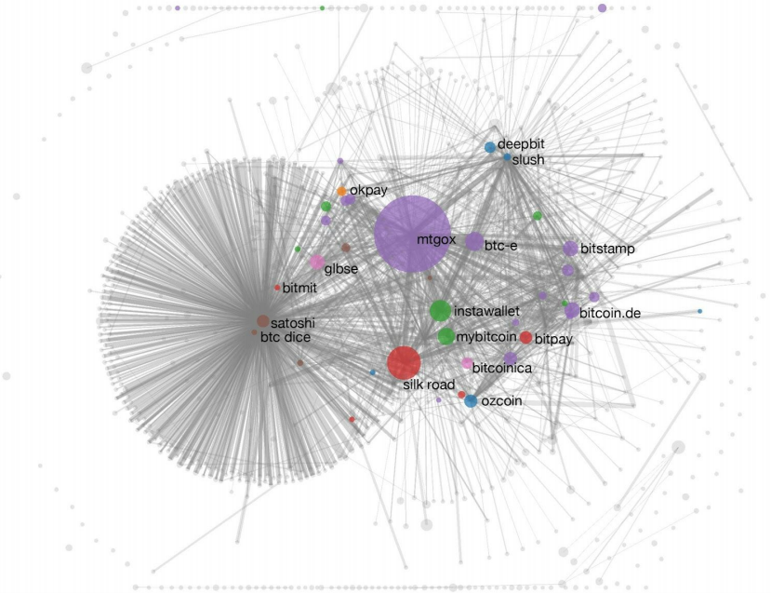
Attaching real-world identities to clusters
Tagging by transacting: to reliably infer addresses, transact with that service provider, e.g., depositing bitcoins, purchasing an item
The service provider’s address will be known and the tx end up in the block chain
By transacting with various Bitcoin service providers, researchers were able to attach real world identities to their clusters.

Slide 53
Identifying individuals
Can we connect little clusters corresponding to individuals to their real-life identities?
Direct transacting
Reveals at least at least one address belonging to an individual
Carelessness
People often post their Bitcoin addresses in public forums
Evolution of deanonymization algorithms
Usually improve over time when the data is publicly available

Slide 54
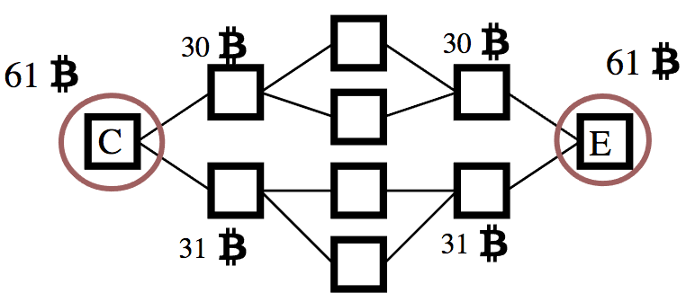
Analysis of the transaction graph
The deanonymization techniques examined so far are all based on analyzing the graphs of transactions in the block chain: transaction graph analysis
Helps to link different bitcoin addresses
Does not uncover IP addresses

Slide 55
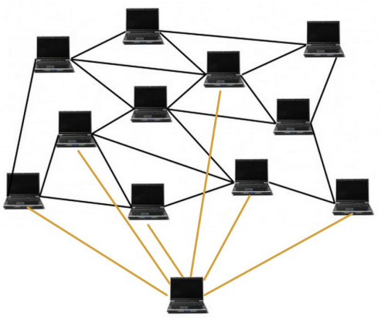
Analysis of the Bitcoin protocol and network
To post a transaction to the block chain, one typically broadcasts it to Bitcoin’s peer-to-peer network
Connects to many nodes at once and broadcasts the transaction
If sufficiently many nodes on the network collude with each other, they could figure out the first node to broadcast any transaction
Bitcoin protocol sniffer
Since Bitcoin protocol data is not encrypted, we could obtain the relationship between Bitcoin address – IP address, and get the real identity with the help of the telecom operator's IP records
Sybil attack
An investigator can attempt to fill the network with nodes controlled by him; users would then be likely to connect only to attacker nodes

Slide 56
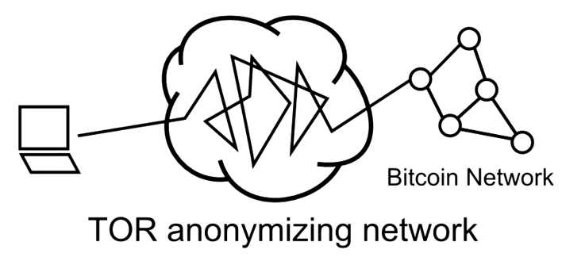
Bitcoin + Tor
If you access Bitcoin through a TOR network that hides your IP address, you can use Bitcoin without ever revealing anything more than your public key

Slide 57
Bitcoin trail obfuscation countermeasures
Analysis of the transaction graph
Obtain transactions from public blockchain data, to classify Bitcoin addresses based on the weakness of Bitcoin anonymity, and to relate Bitcoin addresses to single identities
Analysis of the Bitcoin protocol and network
Makes use of the spreading characteristics of Bitcoin transactions to deduce the source IP address of a new transaction
Notes:
ATC is able to cluster many Bitcoin addresses to one user, or find clue to connect Bitcoin addresses with real or virtual user ID info
ABPN aims to link a new transaction to an IP address so that an attacker could find the relationship between the Bitcoin address and IP address

Slide 58
Conclusões
An essential process involved in cybercrime involves how to perform payments online without leaving a trail
Bitcoin is a groundbreaking virtual currency system that allows for online transactions to be performed securely in a fully decentralized fashion
The anonymity guarantees offered by Bitcoin are quite high, although researchers have been looking at ways to trace users’ identities based on Bitcoin’s public ledger

